Slide 1
Pitching 101: How to Present Your Startups and Technology Innovation to Potential Funders
August 21, 2020 | UCLA TDG
Notes:
MC

Slide 2

Anurag Agarwal
Principal
Life Science Team
Previously
Consultant, Boston Consulting Group
Ph.D., Molecular Cell Biology, WUSTL
B.Tech, Biotechnology, Indian Institute of Technology, Madras

Slide 3
Making the Pitch: Approaching Investors
Notes:
MC

Slide 4
























































Funding Sources for Startups
SOURCE
FUNCTION
STRATEGIC
VENTURE
CAPITAL
GROWTH; RAPID
SCALING
ANGELS AND ACCELERATORS
High Net
Worth
University Angel Network
PROOF OF
CONCEPT
VENTURE PHILANTHROPY
FRIENDS AND
FAMILY
PRE-FUNDED
STARTUP
GRANTS
SCIENCE
PROJECT
Notes:
MC

Slide 5
VC By the Numbers
The majority of startups, and most academic startups, do not require and will not get venture capital
VCs look at 100s of businesses for one investment
OUP tracks ~7,000 companies yet will only make ~40 investments out of our current fund – that’s an acceptance rate of <1%
Notes:
MC

Slide 6
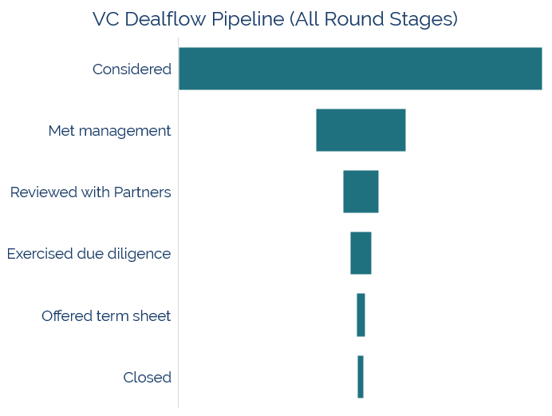
The Likelihood of Getting your Startup Funded by a VC
28%
36%
48%
35%
59%
1 % of deals make it through the process
Source: “How Do Venture Capitalists Make Decisions?”
Notes:
MC

Slide 7

Sliding Down the OUP Deal Funnel
Out of the 230 companies that entered OUP’s diligence process in 2019, under 5% became investments.
Companies tracked in OUP database in 2019
~7,000
Different companies OUP interacted with in 2019
2,114
Companies entered diligence in 2019
230
Total first-time investments in 2019
11
Notes:
How many companies enter diligence each year vs number of investments
7000 companies tracking, 2114 different companies interacted with in 2019, 230 companies entered diligence last year, 11 investments

Slide 8
Initial Interactions & Pitch Decks
  VCs receive MANY pitch decks
  The cliché is true – you only get one chance to make a first impression
    Get introduced by a trusted friend or advisor
  Make your initial interaction (phone call, pitch deck, executive summary) clear, concise, and compelling:
    Who you are
    Data justifying your enthusiasm and commitment
    Why data are compelling
    Addressable market
    Funding and accomplishments to date
    Use of financing proceeds: team, business, technical
Notes:
MC

Slide 9


Who Pitches? Play to your strengths
Entrepreneur
Lead with the team
Product development
Unique market insight/opportunity
Fundraising plan & value creation
Scientist
  Focus on the science and its place in the landscape
  Data! Data! Data!
  Product opportunities
  Next steps, timeline, and milestones
Notes:
MC

Slide 10
Lessons Learned about Raising Capital
Targeting investors
  Investment strategy (sector), stage, and availability of funds
  Unless you’re a ‘rock star’ with prior entrepreneurial success, fundraising is a challenging, potentially grueling, and a long process
  Be prepared for rejection - VCs say “no” far more often than “yes”
  Early stage companies often represent new stories & technologies
    Multiple meetings will be needed
Private placement agents - investors want to work directly with founders
  Only ‘ok’ for late stage companies that are truly ‘too busy’
  Pros: can run an efficient process and identify potential investors
  Cons: 1st impressions; founders still need to be personally involved
Notes:
MC
Link to article: https://lifescivc.com/2016/04/raising-capital-private-biotech-insights-unum-therapeutics-series-b-round/
Running a tight process, where each activity is properly sequenced and timed, is key

Slide 11












Know Your Investor: VCs Invest at Different Stages (Life Science)
Tx
Company formation
Early pre-clinical
IND enabling / IND-ready
Early clinical
Late clinical
NDA / PMA / Commercial
Tx only
All LS
crossover
investors
alternative
models
Note: These are examples. There are many more VCs and there are always nuances
Notes:
MC

Slide 12
General Pitching Guidelines
Pre-empt any ‘killer’ questions
Send full pitch decks in advance
Make slides visually interesting
Use text sparingly, but enough so that one can interpret the slide without presenter
Be clear, concise, compelling
Keep the pitch brief (~15 slides) and have additional details in appendix to address questions
Pause to allow for questions
When you don’t know an answer, say so
Do not hide anything substantive; it won’t stay hidden for long
Do not make unsubstantiated claims and statements. Sooner or later, you’ll need to back them up
Notes:
ES

Slide 13
Elements of a Pitch Deck
Notes:
ES

Slide 14
A Pitch Deck to Impress Investors
1
Intro: Problem & Solution (1 slide)
Grab Attention
Demonstrate expertise
5
Competition (1-2 slides)
Academic and corporate researchers working on the problem and status
What’s in the preclinical and clinical pipeline for this unmet need?
5
2
Leadership (1-2 slides)
Highlight successes of execs and founders
Identify specific new hires contemplated if senior management
6
Operational Plan / Milestones (1-2 slides)
How do capital needs map to milestone achievement?
Timeline for deliverables and future steps
6
3
Market Opportunity (2-3 slides)
Scope and scale of problem you’re solving
Present standard of care (products) and how your solution/product meets an unmet need
7
Financing Strategy (1 slide)
Requested funds and expected progress
Financing history – grants, FFF, angels, VCs
Value inflection points with funding
Any proposed tranching
7
4
Technology & Product (3-10 slides)
Experimental results prompting the ‘eureka’ moment
Where you are in the product/service development process
Future R&D challenges for product development/expansion
8
Summary (1 slide)
What will the company be in 5/10 years?
Notes:
ES

Slide 15
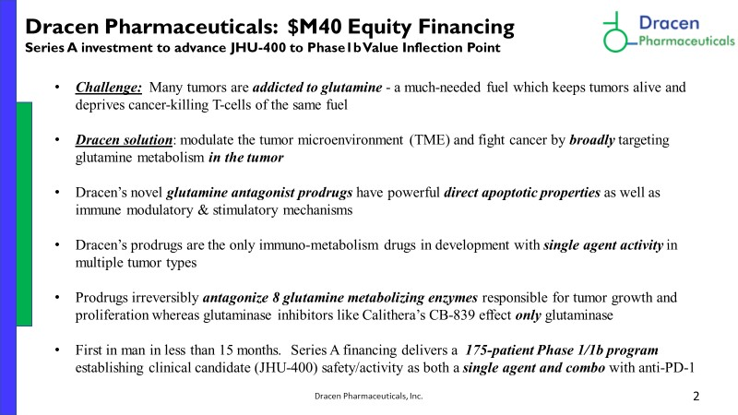
Introduction: Problem & Solution
1
Focus on the science with background on the technology and cover key data points that would capture investor attention
Outline the current status of the program and where it is in the development process
Ask the VC for: help with financing, team building, strategy (such as indication selection)
Notes:
ES

Slide 16
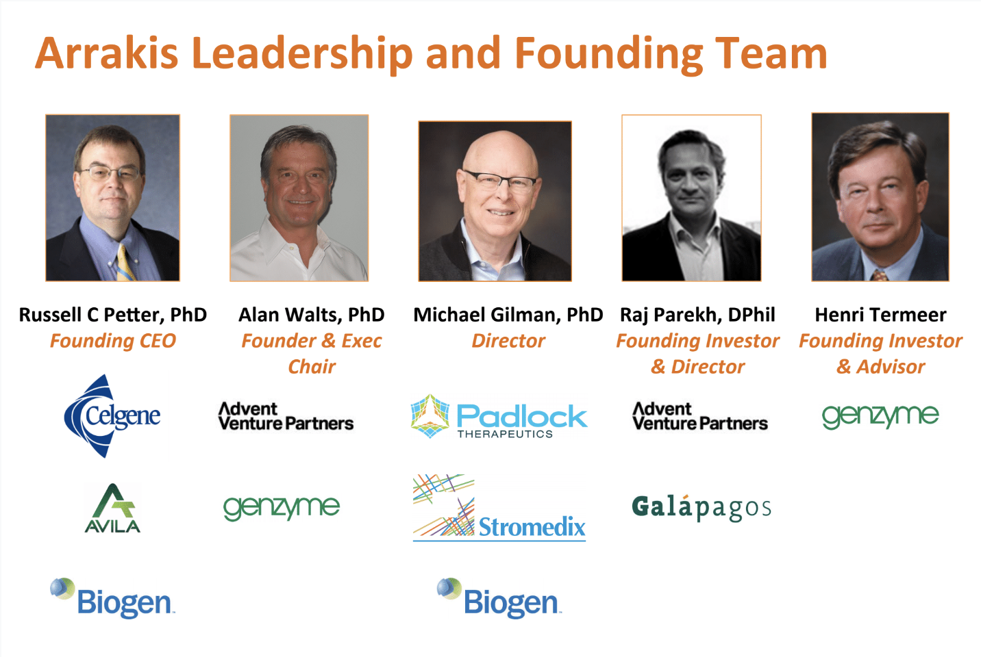
Leadership
2
If there is an executive team, focus on their past experience and specific roles relevant to company activities
  Highlight any role in VC backed companies or experience in related clinical indications
If the company only has scientific founders, focus on everyone’s academic /clinical background that is relevant to the technology
  E.g., Prostate cancer doc; Chemist and inventor of currently approved drug
Notes:
ES

Slide 17
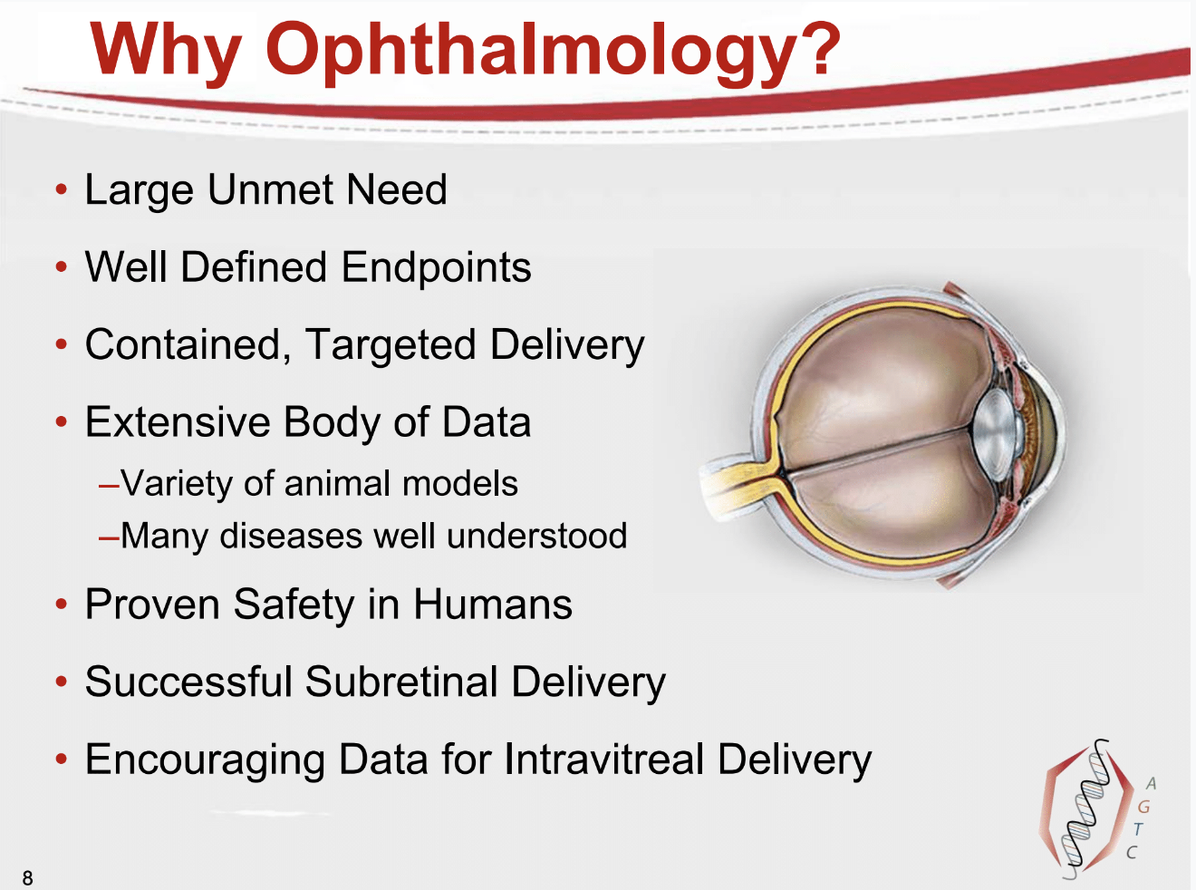
Market Opportunity: Why Now?
3
Focus on the market size and revenue potential for rare disease markets only
Do not define your value based on getting a “small piece of a very large market”
Rather than focusing on market opportunity, focus on different applications the product can be expanded into
Notes:
ES

Slide 18
Market Opportunity: The Problem
3
Describe the problem space and how it works today
Make sure investors understand the complex landscape in which you will operate
Before you present your solution, show where there is friction and inefficiency in the current way of doing things
Identify competitive/synergistic companies addressing the problem
Notes:
ES

Slide 19
Technology & Product: The Solution
4
Your Solution and the Value Proposition
Make a clear connection between the problem and the solution
Try to explain in concise terms what the value proposition is - use quantitative metrics if relevant (e.g., 100x faster for ½ the cost, or eliminate the need for expensive CT scans.
Who realizes the value? Patient, payers, bank, customer, CISOs, developers, etc.
Notes:
ES

Slide 20
Technology & Product: Why this can work
4
Key data that supports claims about the technology
Experimental results prompting the ‘eureka’ moment
If there is a way to demonstrate the product, reserve time for a demo during the pitch (seeing is believing)
Product development roadmap and where you are currently in the plan
Next steps once you secure financing
Notes:
ES

Slide 21
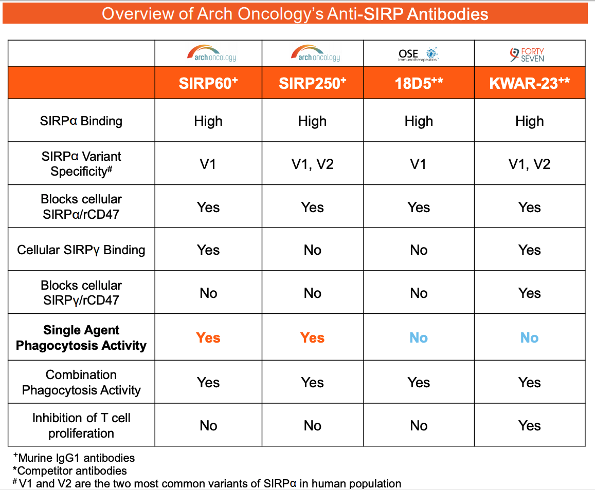
Competition
5
Describe the current State of Care for the addressable patients
Conduct a thorough search on the current treatments in development – especially in late stage development
  If the current treatments in development may change the standard of care or raise the bar, please include the new baseline
Outline technical differences compared to other closely related technologies
Notes:
MC

Slide 22
Operational Plan / Milestones
6
Outline the overall timeline to get through initial proof of concept in the clinic
Show value creating milestones along the drug development path
  Identifying the development candidate, completing IND enabling studies, dosing healthy subjects for PK, demonstrating clinical PoM and PoC
If possible, provide the budget needed to reach each of the value creating milestones
  Include any realistic non-dilutive or BD opportunities that can reduce the capital required or de-risks capital need during development period
Notes:
MC
Rumpus

Slide 23
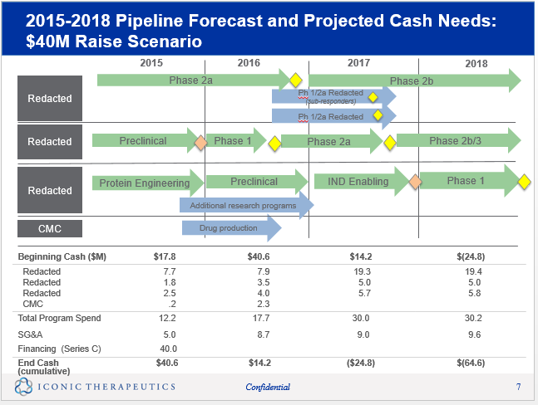
Financing Strategy
7
Requested funds and expected progress
Financing history – grants, angels, FnF
Value inflection points with funding
Financial projections
  Forecast of future costs and revenues
  Know your levers/knobs
  Beware of naïve ambition
Valuations
  In general, let the market decide
  If pressed, tell the VC you want to let the market decide
  If pressed again, have some data in mind and provide a very wide range
Notes:
MC

Slide 24
Summary and Vision
8
What does the company aspire to be?
What will this look like in 5 years in success?
Summarize the strongest features of the company: team, current traction, current investors, partners, advisors, technology, etc.
Verbally ask for feedback and potential next steps
Notes:
MC

Slide 25
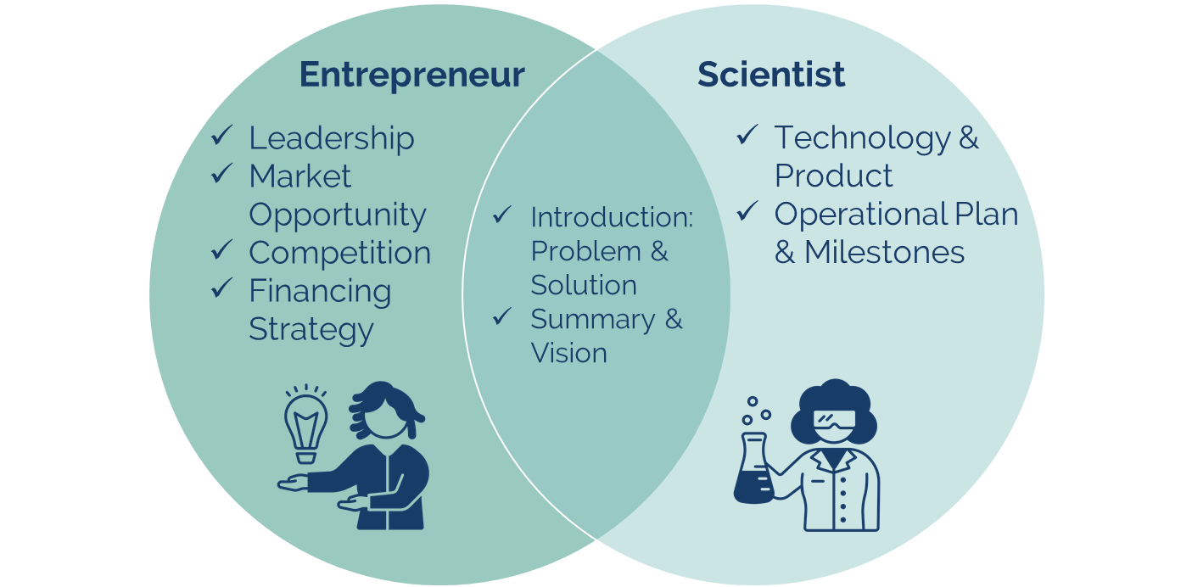
Summing it all up
Great pitch decks clearly show:
  Strength of the team
  Compelling product/science vision
  Clear value creating investment opportunity
And, great ‘pitchers’:
  Balance modesty & passion
  Read the room
  Play to their strengths
Notes:
MC
As a reminder, a pitch deck presented by a scientist will focus on the technology, it’s place in the landscape, product development, and milestones. A pitch deck presented by an entrepreneur will focus on the team, market opportunity, product development, commercialization plan, and use of funds.

Slide 26
Thank You
Summary
Osage University Partners (OUP) invests in startups that have licensed technologies from universities and research institutions. OUP has partnered with over 100 institutions to invest in pioneering technologies and visionary entrepreneurs targeting large market opportunities. The Fund invests across a range of technology sectors and company stages, and typically co-invests with other leading venture funds.
Contacts
Anurag Agarwal, Principal | anurag.agarwal@oup.vc
\
Address
50 Monument Rd, Suite 201 Bala Cynwyd, PA 19004
484.434.2255
oup.vc

