Slide 1

UCLA
Azar Nazeri
Institute of Technology Advancement
UCLA Henry Samueli School of Engineering and Applied Sciences

Slide 2
OverView
What is NSF I-Corps
Why I-Corps
How it works
Who Qualifies

Slide 3
What is I-Corps
I-Corps is a process that helps you determine:
  Can you build a viable business around your innovation(s)?
  What do your customers care about?
  Do you have product-market fit?

Slide 4
Program Goals
LEVERAGES NSF research investments
Contributes to the nation’s INNOVATION ECOSYSTEM
New and increased focus on student and faculty entrepreneurship education
Reduce the time and risk of commercialization and build higher QUALITY STARTUPS, entrepreneurial culture and skills

Slide 5
Why NSF wants to do this?
NSF spends over $7 Billion annually in support of fundamental research
Congress asks for economic outcome

Slide 6
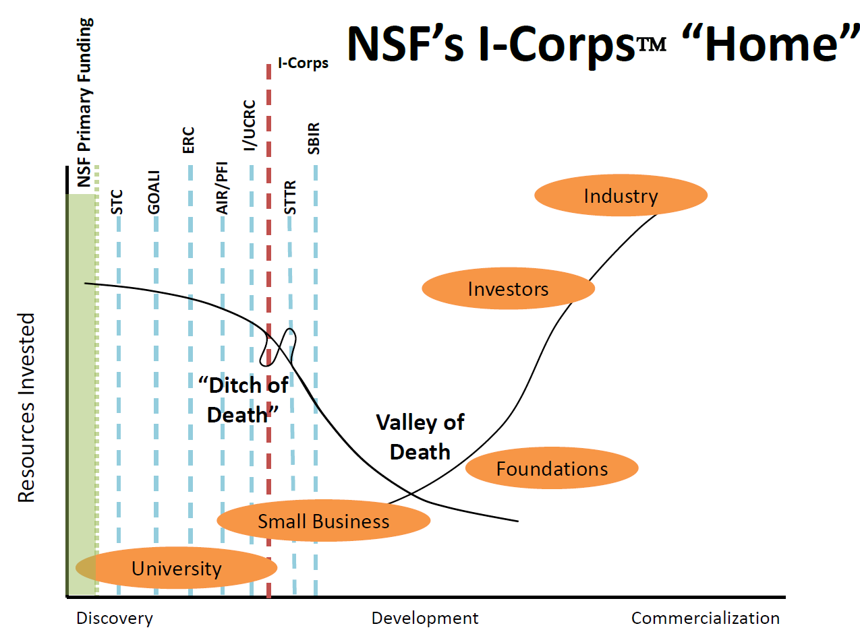

Notes:
The term 'valley of death’`is a common term in the entrepreneurship world, alludes to the difficulty in maturing technologies through this demonstration and validation stage due to a number of barriers, which ultimately lead to a failure to transfer many new technologies to industry.

Slide 7
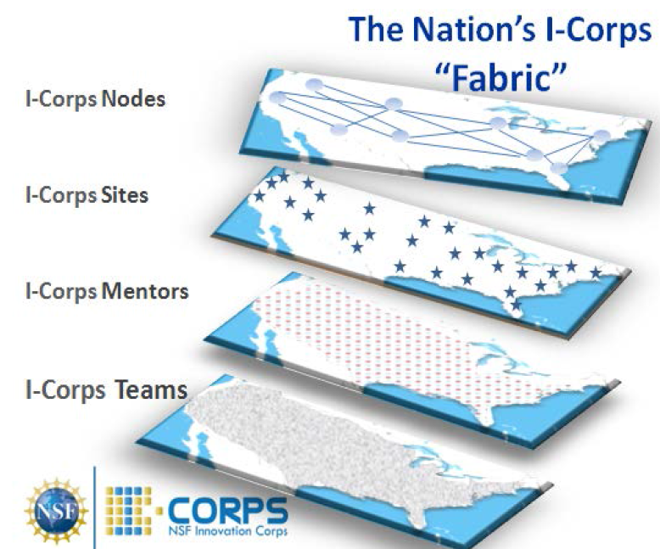

Slide 8
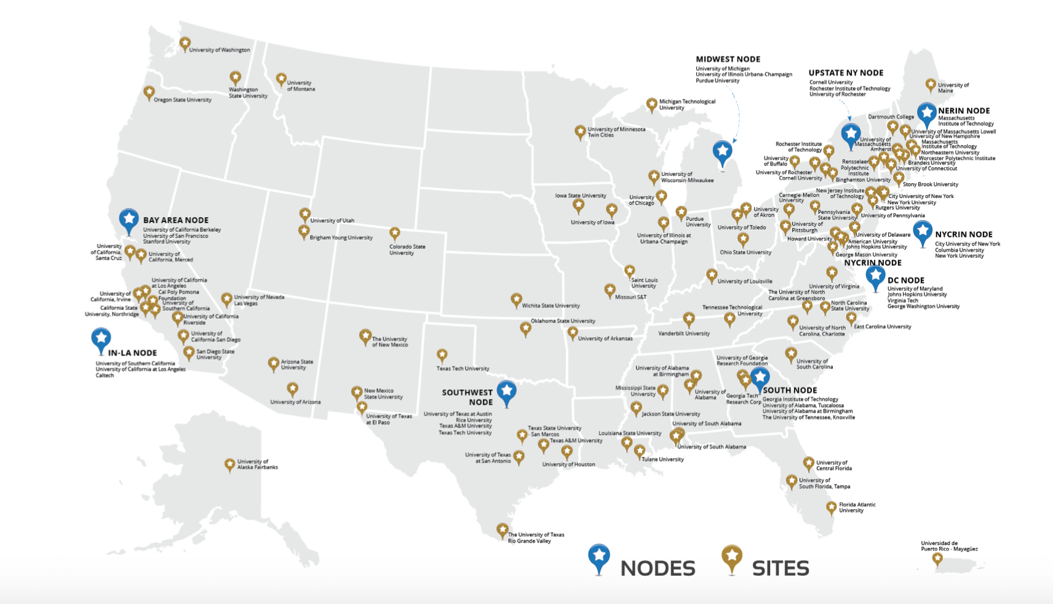

Slide 9
I-Corps Nodes
ID, Develop & Support promising ideas
Enhance Innovation Capacity
Track, Analyze & Evaluate participants
Share Best practices across the nation
Deliver Curriculum for nationally selected I-Corps Teams

Slide 10
USC/UCLA/Caltech “LA” Node
(Award Date: Nov. 1, 2014)
UCLA (ITA)
USC School of Engineering & USC Marshall
Caltech
Plus more than 15 other universities collaborating

Slide 11
What is the difference between
a company
and
a startup?

Slide 12

Notes:
A startup on the other hand is centered around an idea supported by a few people but surrounded by a lot of unknowns. Therefore, it cannot be in the exectuion mode. I-Corps program is focusing on the help with figuring out the unknowns and turning them into knows before going into the execution mode.

Slide 13

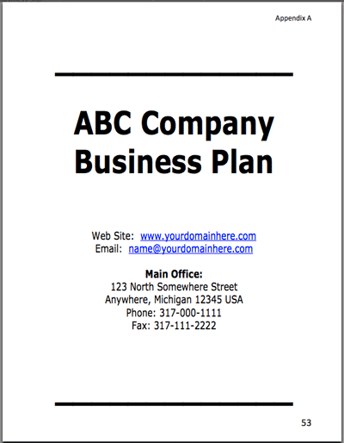
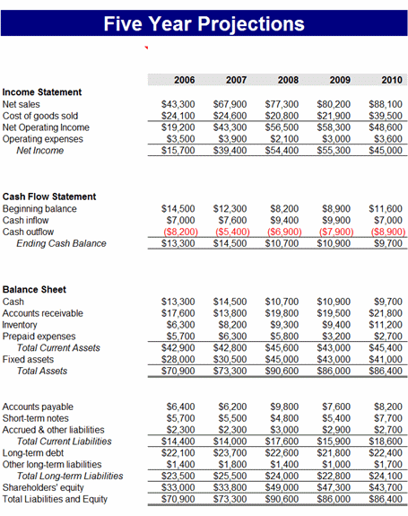
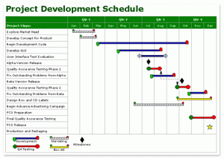
Executive Summary
Mission Statement
Company Background
Product Description
Competitive Analysis
SWOT Analysis
Marketing Plan
Operations Plan
Financial Projections
Timeline
Notes:
Let’s start with a company. Company starts with a bunch of knowns from the executive summary to misssion statement to marketing strategy, so the company has a business plan based on all the knows and is ready to execute.

Slide 14
Startup | Company
idea – might not have a prototype | clearly defined product
customer segment too broad, if any | focused
few people – no division of tasks | well defined titles
lack of resources | investment
not ready to sell | selling
value not quantified, not clear | value quantified
Business Model Canvas | Business Plan
SEARCH | EXECUTE

Slide 15
Notes:
Read the slide – rhtorical question, dot expect answer

Slide 18

Notes:
From small ideas to the one that attracted hundreds of millions of dollars!

Slide 19
Notes:
Are you familiar with Juicero? ? It was a Silicon Valley startup that raised $120 million from investors. Shot down in Sept 2017. $400 machine was revealed to be the equivalent of two hands squezzing a bag of juice. .

Slide 20
Notes:
Webvan is an online grocery shopping service that collected $800 million ($400 in private and $400 in public) in a short period of time with which they expanded quickly by building a warehouse and buying a fleet of trucks. They went out of business due to lack of customers. We will revist this example shortly.

Slide 22
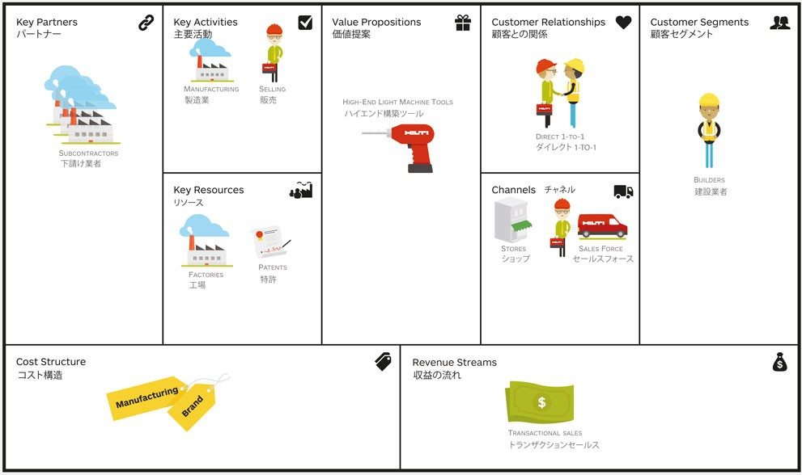

Product Market Fit
Operations View
Will we make money?
Notes:
A business Model Canvas is a way of organizing essential components of a business. It is a tool to

Slide 23
Product Market Fit
Notes:
A business Model Canvas is a way of organizing essential components of a business. It is a tool to

Slide 24
The Course
Developed by entrepreneurs
Taught by Entrepreneurs
Requires Interviews...
Search for... Product-Market Fit
Build a... Business Model
Evaluate the opportunity to... Go/No-Go
Flipped Classroom

Slide 25
Getting Out of The Building
This class is not about lectures
The class is not about attendance
The class is about the work the entire team does outside the building

Slide 26
I-Corps is not about
Funding to improve your innovation
Raising funding
Writing grants
Writing papers
Writing business plans
Selling
Pitching
I-Corps is NOT a competition
Notes:
Read the slide

Slide 27
I-Corps is ABOUT
Reducing Risk,
Improving Odds

Slide 28
What is I-Corps
$50k grants -- focus on PRODUCT-MARKET FIT
Nimble review and funding
Team-based
Curriculum/Process focus

Slide 29
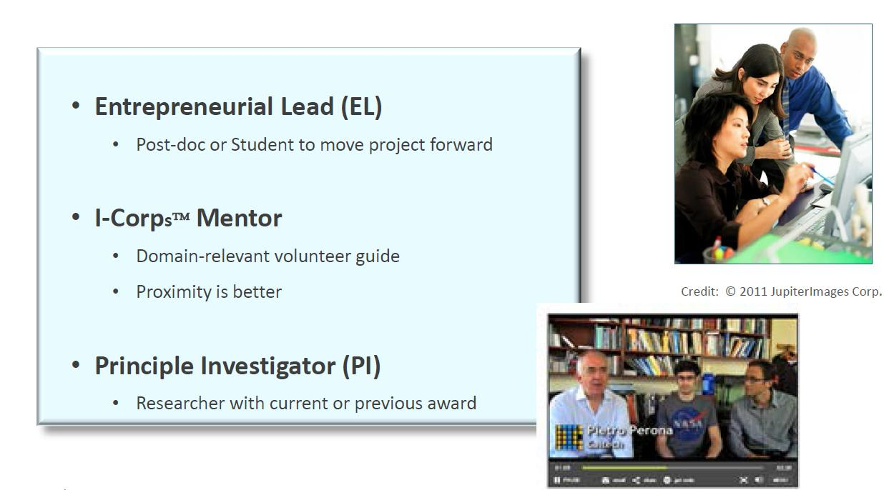

Slide 30
Invited to ZAP
Invited to BOOM
Application to National I-Corps
Application to IN-LA sponsorship
ROAD TO
NATIONAL
I-CORPS
@ IN-LA

Slide 31
BOOM
2 sessions
National I-Corps
10 sessions
10 interviews
100 interviews
5 interviews
2 sessions
ZAP!
1 week apart
one week apart
7 weeks
combination of in-person and virtual
$50 k!!
online
in-person
total of 8 hours
total of 3 hours
I-CORPS
CIRRICULUM

Slide 32
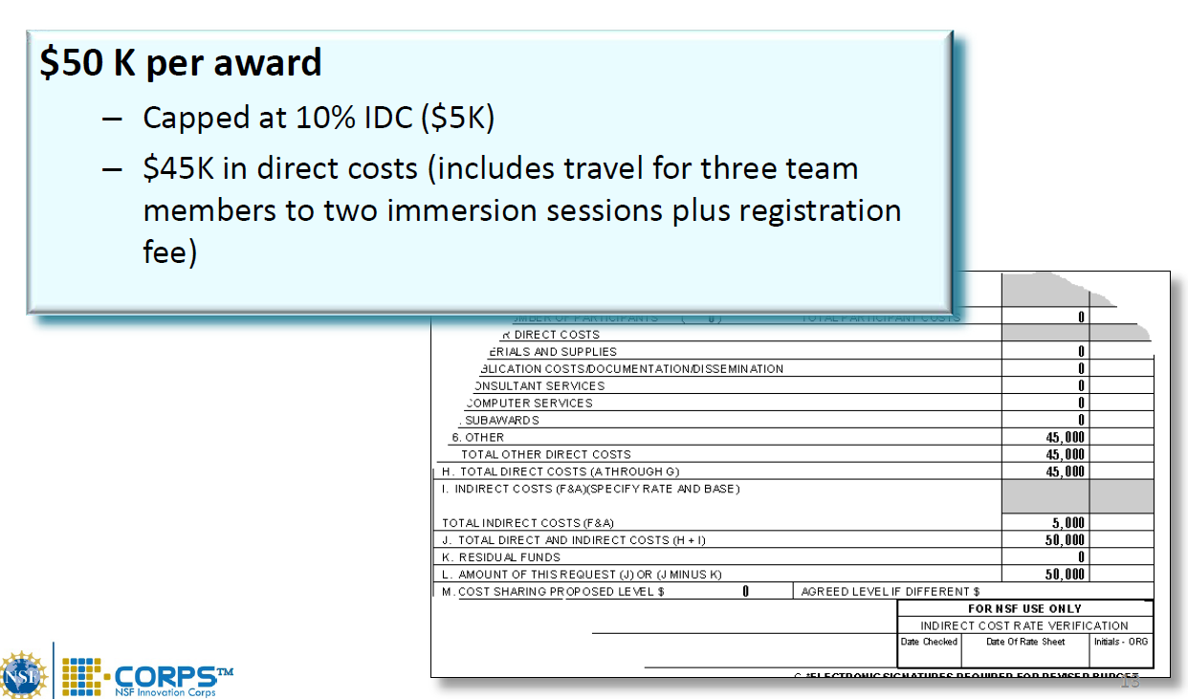
I-Corps Team Program Details – Team Budget

Slide 33
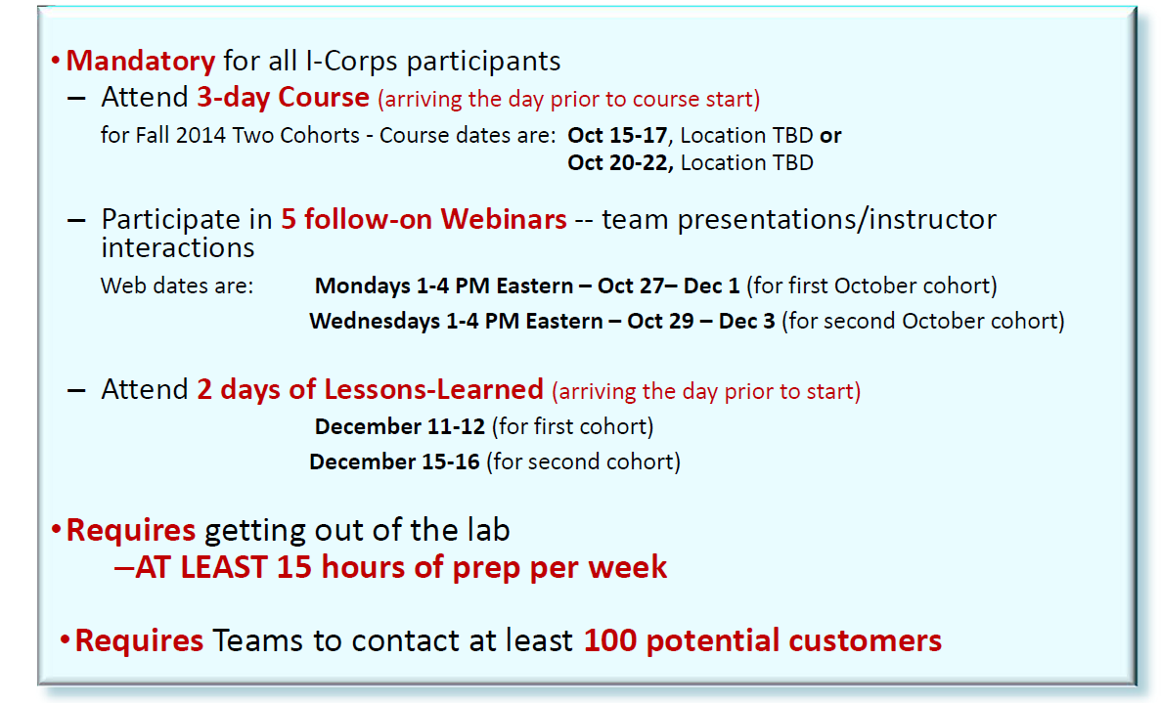
I-Corps Team Curriculum Delivery

Slide 34
            Timeline
Pick your own pace
Program can be completed in as little as little as two months
After you complete ZAP & BOOM, you have one year to apply to the national program
Once you get your $50k, you have 6 months to use it in your customer discovery

Slide 35

Are You Eligible?
PI: NSF award (current or expired <5 years ago)
Complete a regional training
Have a deep technology
Committed to the entire program
Entire team available for off- site Workshops and on-site Curriculum

Slide 36
Interviews
We will have an initial telephone conference call with your entire team and NSF I-CorpsTM program officers.
If this interview part of the process goes well ...
2. We will have a final conference call with your team, NSF, and a group of I-CorpsTM Instructors. If this goes well, you will be asked to submit a proposal.

Slide 37
NSF I-Corps Statistics
500 teams have been through our LA Node regional program
95% NSF acceptance rate of our teams at the interviews
1,700+ teams have received $50k
75 teams from LA Node
11 from UCLA
I-Corps teams have 50% greater chance of approval for SBIR/STTR

Slide 38
More Information
www.nsf.gov/i-corps
https://www.ita.ucla.edu/i-corps/
We can meet with you individually, please request an individual zoom session.
Contatcs:
Azar Nazeri anazeri@ucla.edu
Melike Bulu Taciroglu melike9@g.ucla.edu

