Slide 1
Small molecule modulators that mediate PINK1 and Parkin trafficking in mitochondria
Two small molecule probes that attenuate the PINK1/Parkin pathway to elucidate the mechanism of mitophagy
Dr. Carla Koehler, Ph.D.
UCLA Department of Chemistry & Biochemistry Los Angeles, California

Slide 2
Overview
Neurodegenerative diseases, with a predicted global market size of $39.4 billion by 2024, have been linked to a dysfunctional mitochondrial quality control system that is partially maintained by the proteins PINK1 and Parkin.
The existing methods to study this pathway focus downstream of PINK1 on Parkin recruitment, and commonly utilize mitochondrial uncouplers.
UCLA scientists have developed two novel chemical probes targeting the mitochondrial translocases that regulate mitophagy by attenuating PINK1/Parkin trafficking.

Slide 3
Mitophagy is a crucial pathway that selectively degrades dysfunctional mitochondria to keep the cell healthy.
Deregulation of mitophagy has been implicated in various human diseases, including neurodegeneration.
Certain mutations in PTEN-induced putative kinase (PINK1), a mitochondrial serine kinase, and Parkin, a cytosolic E3-ubiquitin ligase, lead to early onset familial Parkinson’s disease.
When functioning normally, these proteins serve to selectively degrade damaged mitochondria.
Credit: APDAParkinson

Slide 4
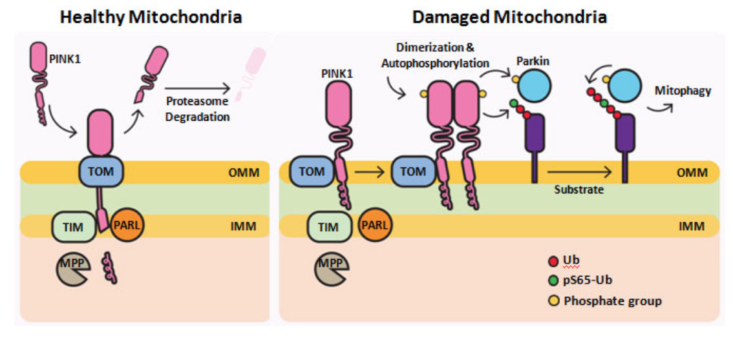
The molecular mechanisms for PINK1 trafficking in mitochondria and its subsequent recruitment of Parkin remain largely unknown.
In healthy mitochondria, PINK1 is imported through the outer membrane and spans the inner mitochondrial membrane, whereas in unhealthy mitochondria, PINK1 cannot be imported into the mitochondria, and accumulations of PINK1 on the outer membrane recruits Parkin to initiate the mitophagy.
Loss of function in either of these genes results in accumulation of dysfunctional mitochondria and eventually leads to neuronal death.
Credit: Nguyen et al., Trends in Cell Biology 2016
Novel methods are needed to further characterize the mitophagy pathway.

Slide 5
Novel mitophagy research tools targeting the PINK1/Parkin pathway.
UCLA researchers have developed two novel small molecule probes, MB-10 and DECA, that modulate PINK1 and Parkin trafficking in mitochondrial in human cells that provide new approach to elucidate the mechanism of mitophagy.

Slide 6
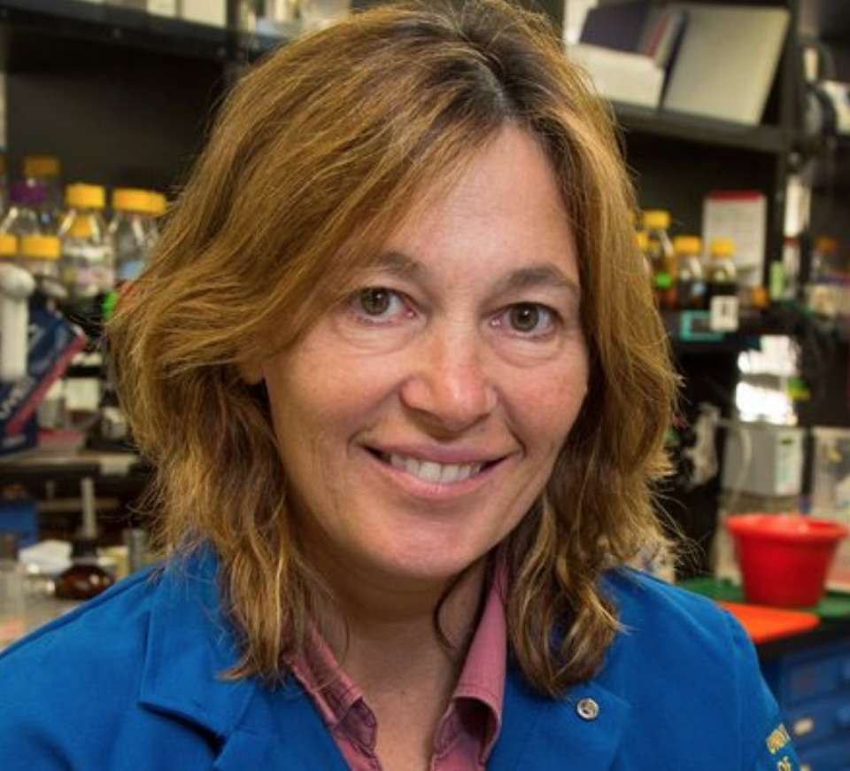
Team: Industry leader in mitochondrial biogenesis, protein import, and the basis of mitochondrial disease.
Dr. Carla Koehler, Ph.D.
Professor of Chemistry & Biochemistry; UCLA
Member, UCLA-Jonsson Comprehensive Cancer Center
Member, Molecular Biology Institute; UCLA
Member, Brain Research Institute; UCLA
Member, UCLA ACCESS Program

Slide 7
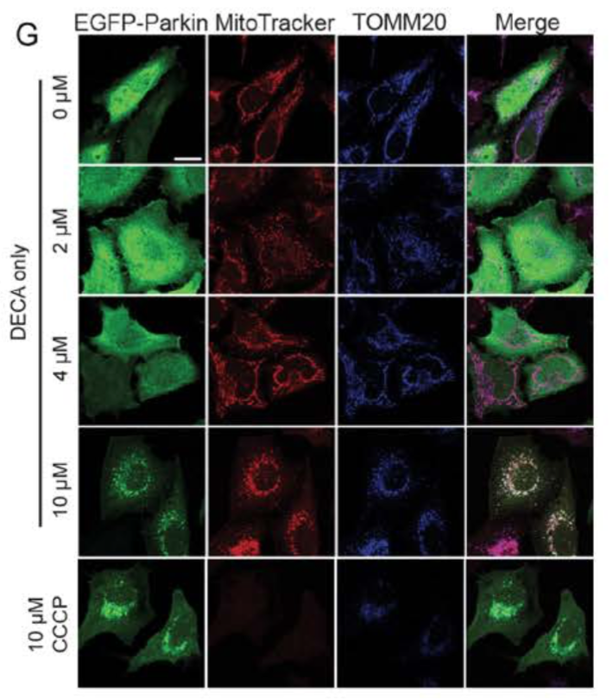
MB-10 and DECA modulate PINK1 and Parkin trafficking in mitochondria.
MB-10 alters mitochondria trafficking, to lessen PINK1 accumulation and subsequent Parkin recruitment is impaired.
DECA causes PINK1 accumulation on the mitochondrial outer membrane, to allow Parkin recruitment and degradation of mitochondria via mitophagy.
Upon increasing concentrations of DECA, Parkin (green) accumulates on mitochondria (red).

Slide 8
These small molecule probes will facilitate studying the induction of PINK1-dependent mitophagy in cells and animal models.

Slide 9
These small molecules are improved over previous strategies to study mitophagy.
Targeted inhibitor of the PINK1/Parkin pathway, rather than targeting the downstream effects of the accumulation of PINK1 and Parkin.
These are stable and effective small molecule probes.
DECA does not uncouple or impair mitochondria severely, compared to uncouplers and respiratory inhibitors.

Slide 10
Market Opportunity

Slide 11
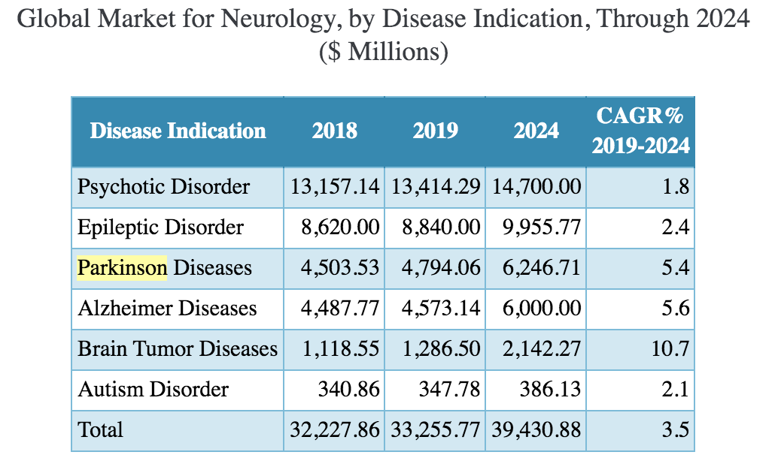
The generalized global market for neurology is predicted to be valued at $39.4 billion by 2024.
Analysis of the neurology global market was performed with information from BCC Report PHM215A.
.

Slide 12
Invention competition: Strategies for the study of mitophagy
Directly probing PINK1/Parkin pathway
Overexpression of misfolded proteins in the matrix
This technology
Mitochondrial uncouplers
Unnatural cellular conditions
Natural cellular conditions
Genome-wide siRNA screens coupled to high-content microscopy
Genome-edited coincidence reporter
Downstream of PINK1 on Parkin recruitment

Slide 13
The neurology market is growing at a CAGR of 3.5%, and is favorable for manufacturer's entry.
The growing prevalence of neurological disorders, increased government funding, and an ever-growing demand for research focused on drug discovery for development of novel therapies are driving the growth of neurology market.
MB-10 and DECA are valuable chemical probes to dissect PINK1/Parkin events on the mitochondrial surface, and for the study the induction of PINK1-dependent mitophagy.
These probes will help to further understand neurodegenerative disease pathologies.
CREDIT: THEHEALTHSITE.COM

