Slide 1
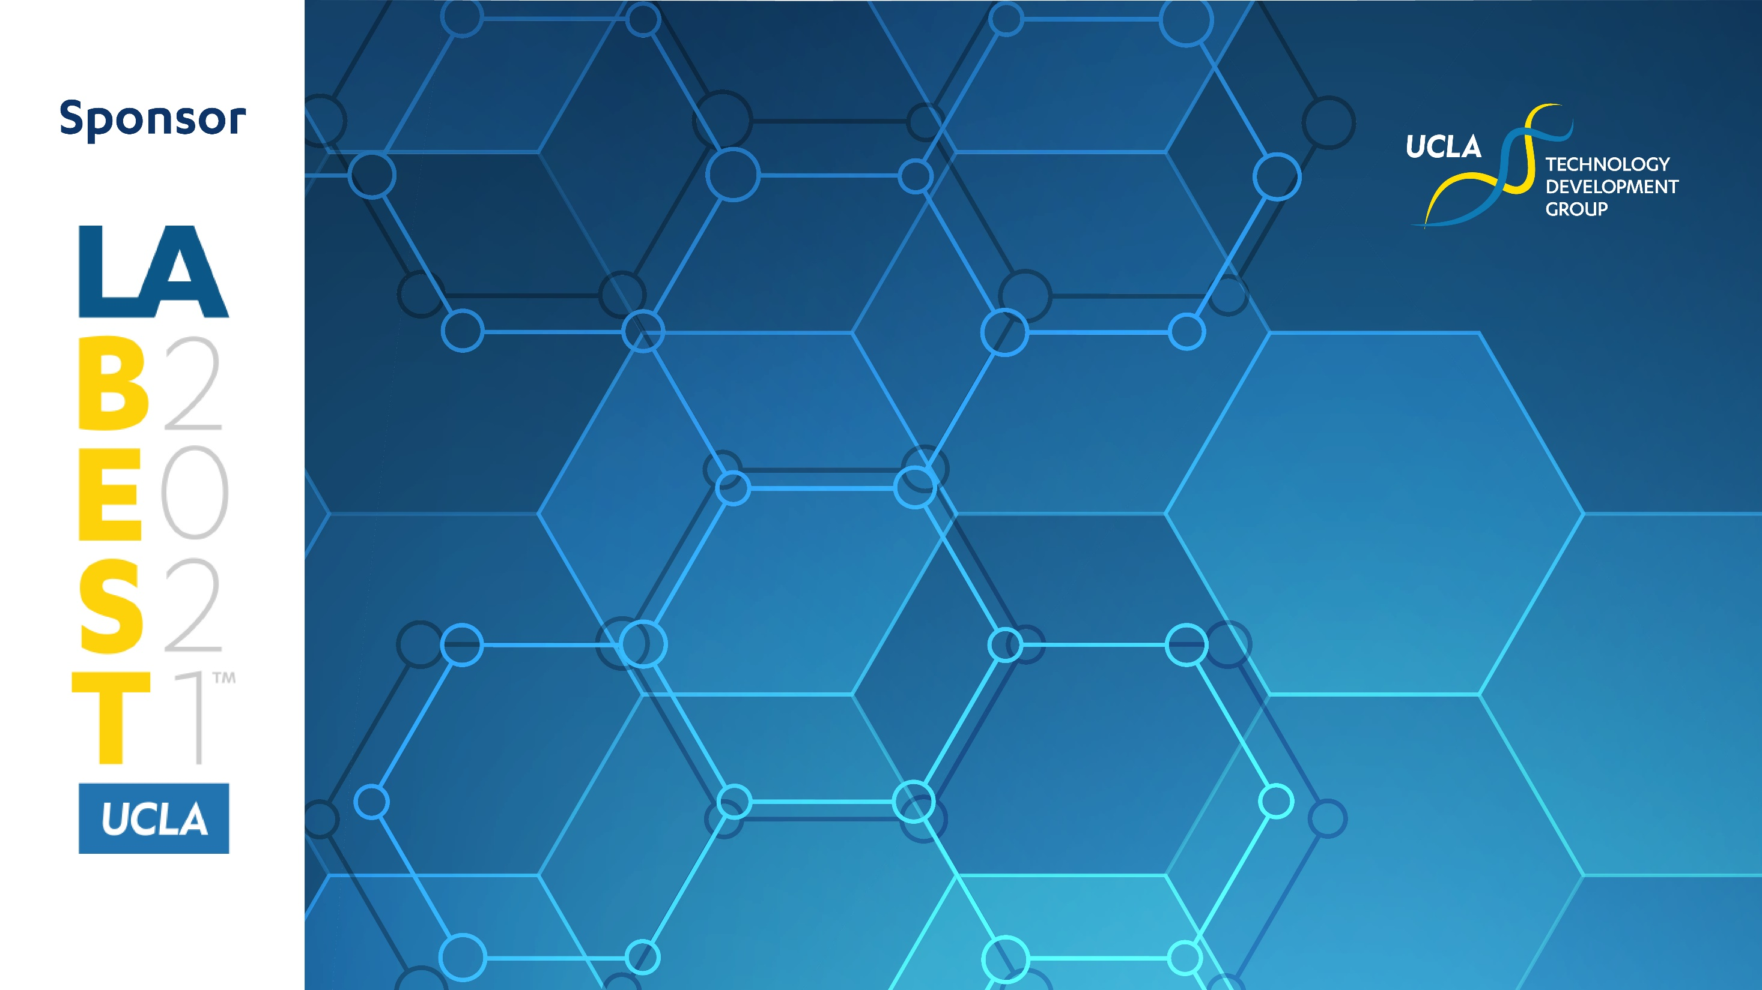
THE UCLA LABEST PEARL COHEN POSTER AWARD WINNERS

Slide 2
THE UCLA LABEST PEARL COHEN POSTER AWARD WINNERS
Presented by: Mark Cohen, Senior Partner & Chair, Life Sciences Practice Group, Pearl Cohen Zedek Latzer Baratz
Cancer
Neuroscience
1st Place: Ralf Buettner, Steve Rosen Lab, CoH
Targeting Acute myeloid Leukemia (AML) with THE NUCLEOSIDE ANALOG 8-CHLORO-ADENOSINE
2nd Place: Yanruide Li, Lily Yang Lab UCLA
Allogenic iNKT Cells for Cancer Immunotherapy
1st Place: Srbui Azarpetian Thomas Carmichael Lab, UCLA
hiPSC-Glial Enriched Progenitors Enhance Motor Recovery and Axonal Growth after White Matter Stroke
2nd Place: Jennifer An, Jason Hinman Lab, UCLA
New Drugs for Stroke Recovery
Regenerative Medicine
Cardio-metabolism
1st Place: Megan Rexius, Megan McCain Lab, USC
Targeting Acute myeloid Leukemia (AML) with THE NUCLEOSIDE ANALOG 8-CHLORO-ADENOSINE
2nd Place: Sean Atamdede, Carla Koehler Lab, UCLA
Mediating Mitochondrial Dynamics
Precision Health
1st Place: Xuexiang Zhang, Song Li Lab, UCLA
Dental Patch for Peridontitis
2nd Place: Kathleen Cunningham, Leanne Jones Lab, UCLA
Neuroglian/L1CAM Regulate Drosophila Intestinal Stem Cell Proliferation
1st Place: Marwa Ben Haj Salah, John Rossi Lab, CoH
Redox-sensitive meta-stable junction for multivalent delivery of therapeutics
2nd Place: Isaura Frost, Paul Weiss Lab, UCLA
SLIPS-Coated Rapid Deformation Device for Intracellular Delivery
I3T
Rare Diseases
1st Place: Mahdi Hasani, Manish Butte Lab, UCLA
COVID-19 Vaccine Booster
2nd Place: Huan Peng, Iris Chen Lab, UCLA
Abalation of Aeruginosa by Photothermal Therapy
1st Place: Michael Emami, Melissa Spencer Lab, UCLA
Identifying New AAV Serotypes with Muscle Stem Cell Tropism
2nd Place: Angel Ni, Rachelle Crossbie Lab, UCLA
Cell-matrix interactions in muscular dystrophy-associated cardiomyopathy

